Slide 1


Rocket Launch Simulation with Vpython
-Date: 2018.1.12-
21011
21018
Notes:
yee

Slide 2
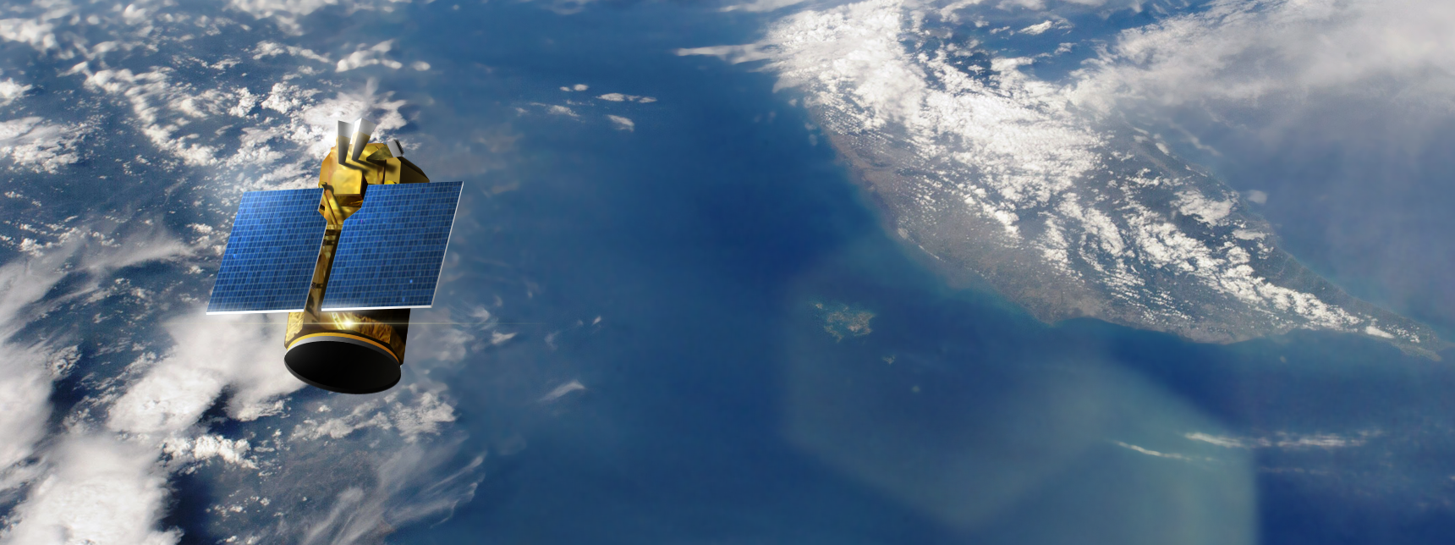
Inspiration
Formosat-5 Mission
Image By Tiouraren (Y.-C. Tsai) - Own work, CC BY-SA 4.0, https://commons.wikimedia.org/w/index.php?curid=61101785
Notes:
LC: 2017年8月24日
憧憬
接要怎麼做才能把衛星送上space

Slide 3

BUT HOW?
Notes:
以火箭發射時程來解釋

Slide 4
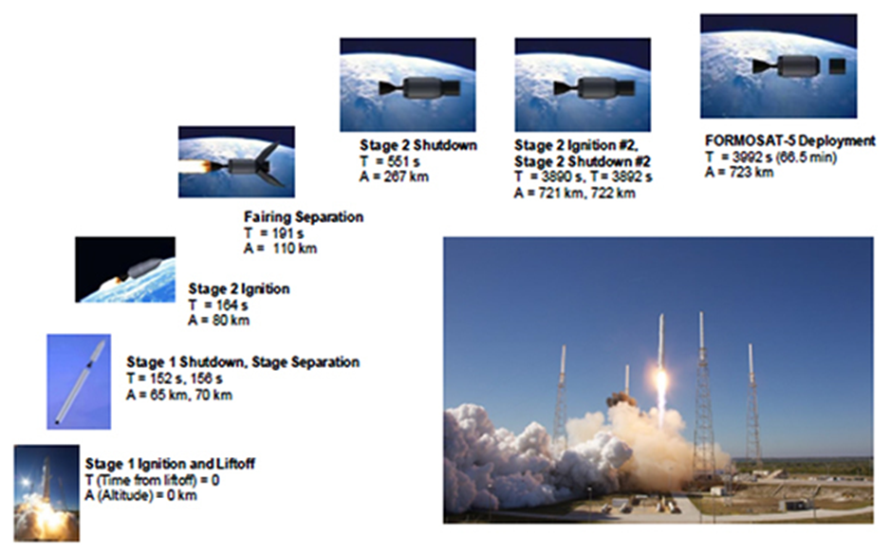
Formosat-5 Launch Process

Slide 5
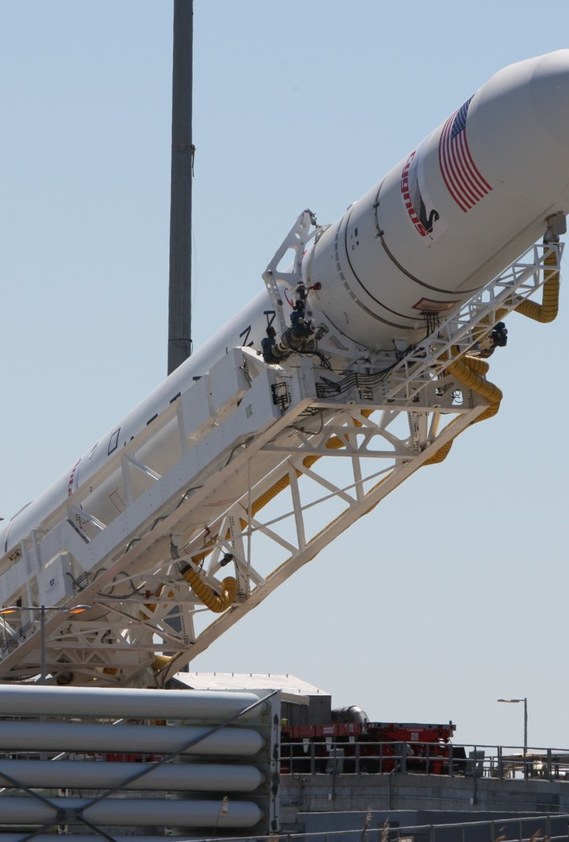
Phase 0: Preparation (T-)
01:08:00 Launch Conductor takes launch readiness poll
01:00:00 RP-1 (rocket grade kerosene) loading underway
00:35:00 LOX (liquid oxygen) loading underway
00:07:00 Falcon 9 begins engine chill prior to launch
00:01:00 Flight computer commanded to begin final prelaunch checks
00:01:00 Propellant tank pressurization to flight pressure begins
00:00:45 SpaceX Launch Director verifies go for launch
00:00:03 Engine controller commands engine ignition sequence to start
00:00:00 Falcon 9 liftoff
In our program, there’s no need to load fuel
So, we just added keyboard control
(Press Spacebar to Launch)

Slide 6
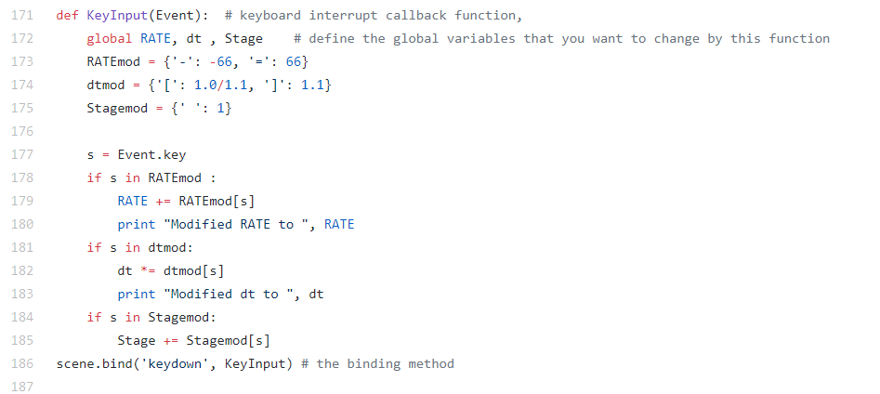
Phase 0: Preparation (T-)
01:08:00 Launch Conductor takes launch readiness poll
01:00:00 RP-1 (rocket grade kerosene) loading underway
00:35:00 LOX (liquid oxygen) loading underway
00:07:00 Falcon 9 begins engine chill prior to launch
00:01:00 Flight computer commanded to begin final prelaunch checks
00:01:00 Propellant tank pressurization to flight pressure begins
00:00:45 SpaceX Launch Director verifies go for launch
00:00:03 Engine controller commands engine ignition sequence to start
00:00:00 Falcon 9 liftoff
In our program, there’s no need to load fuel
So, we just added keyboard control
(Press Spacebar to Launch)

Slide 7
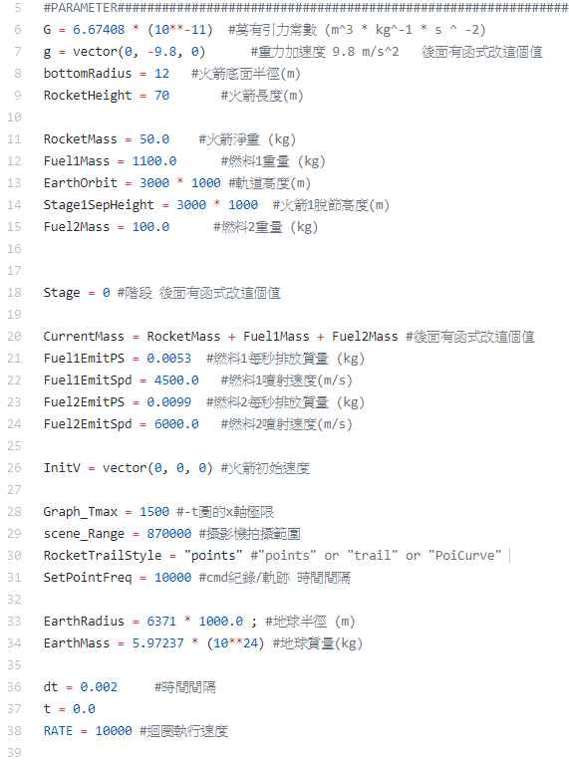
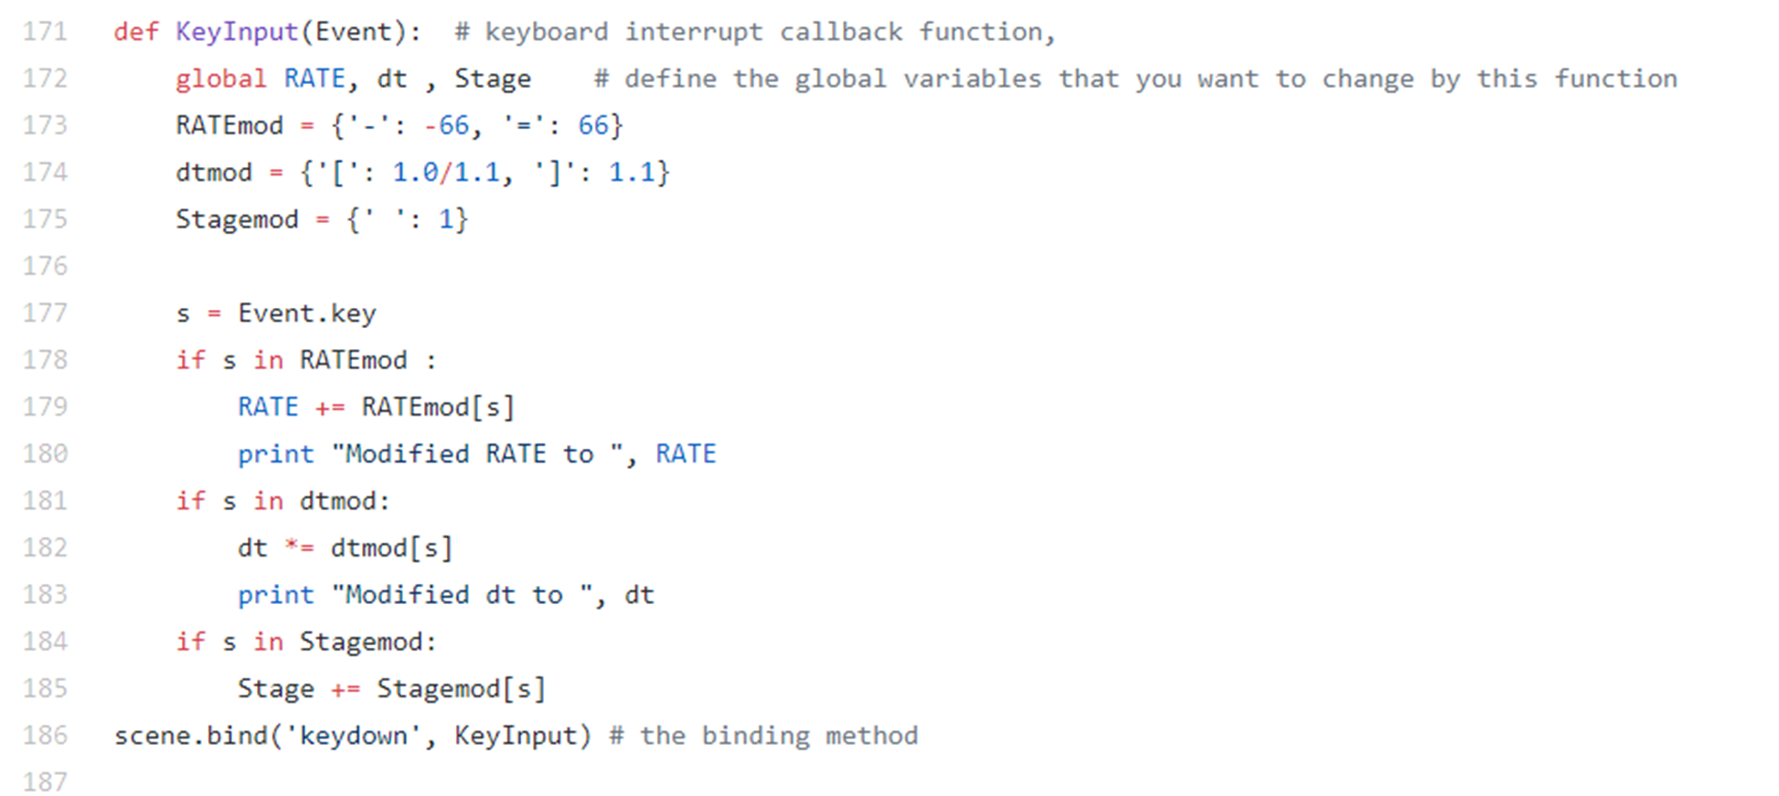
Phase 0: Preparation (T-)
01:08:00 Launch Conductor takes launch readiness poll
01:00:00 RP-1 (rocket grade kerosene) loading underway
00:35:00 LOX (liquid oxygen) loading underway
00:07:00 Falcon 9 begins engine chill prior to launch
00:01:00 Flight computer commanded to begin final prelaunch checks
00:01:00 Propellant tank pressurization to flight pressure begins
00:00:45 SpaceX Launch Director verifies go for launch
00:00:03 Engine controller commands engine ignition sequence to start
00:00:00 Falcon 9 liftoff
In our program, there’s no need to load fuel
So, we just added keyboard control
(Press Spacebar to Launch)

Slide 8
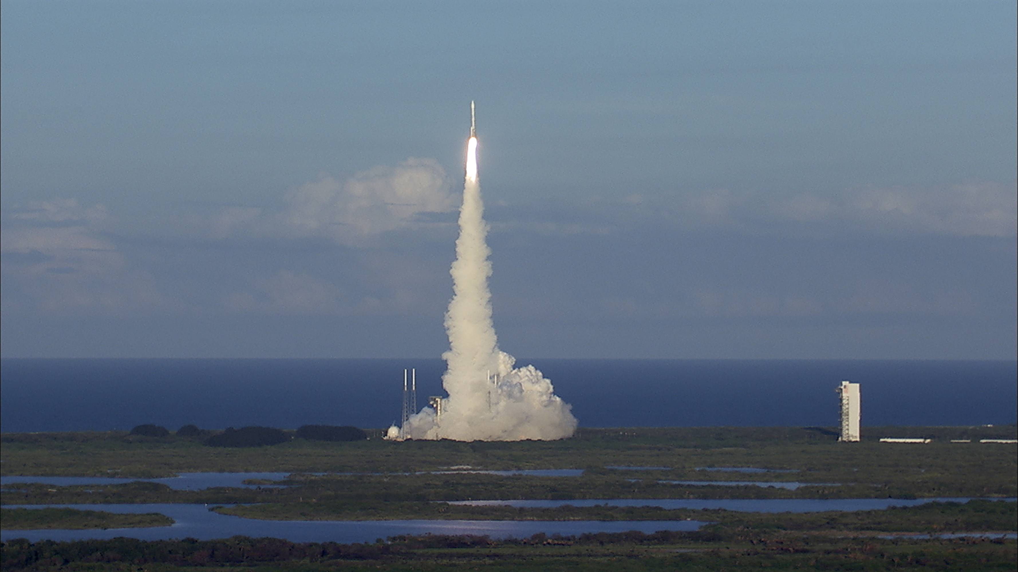
Phase 1: Stage 1 Ignition & Takeoff
Because the mass changes every moment, so F=ma doesn’t work properly
Instead, we use “Conservation of momentum” (動量守恆)

Slide 9
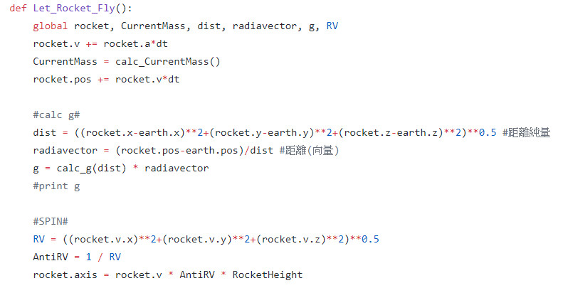
Phase 1: Stage 1 Ignition & Takeoff
Because the mass changes every moment, so F=ma doesn’t work accurately
Instead, we use “Conservation of momentum”

Slide 10
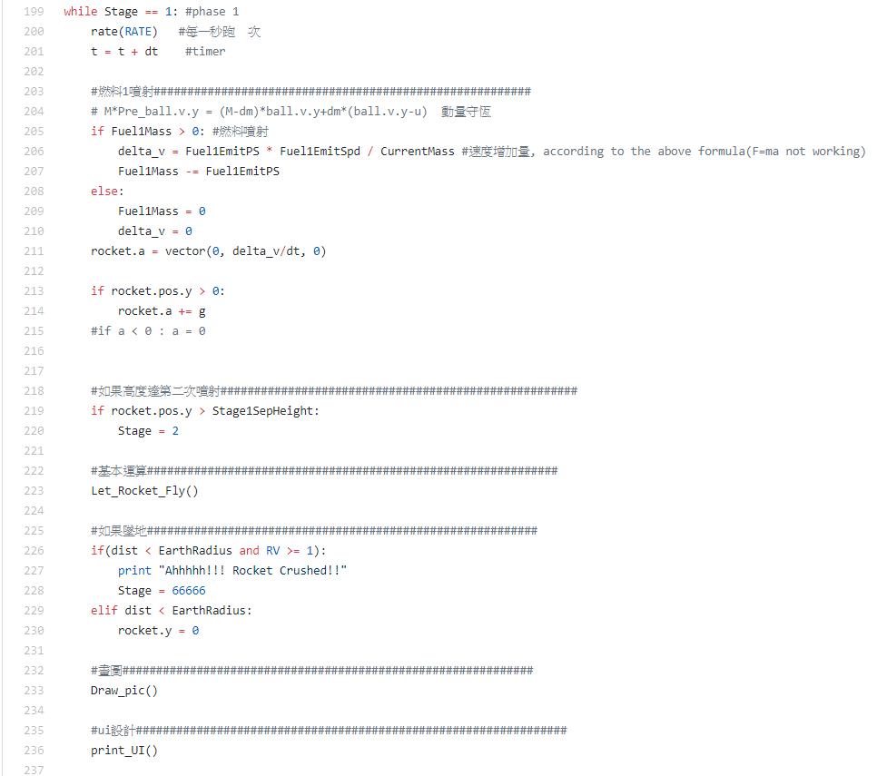
Phase 1: Stage 1 Ignition & Takeoff
Because the mass changes every moment, so F=ma doesn’t work accurately
Instead, we use “Conservation of momentum”

Slide 11
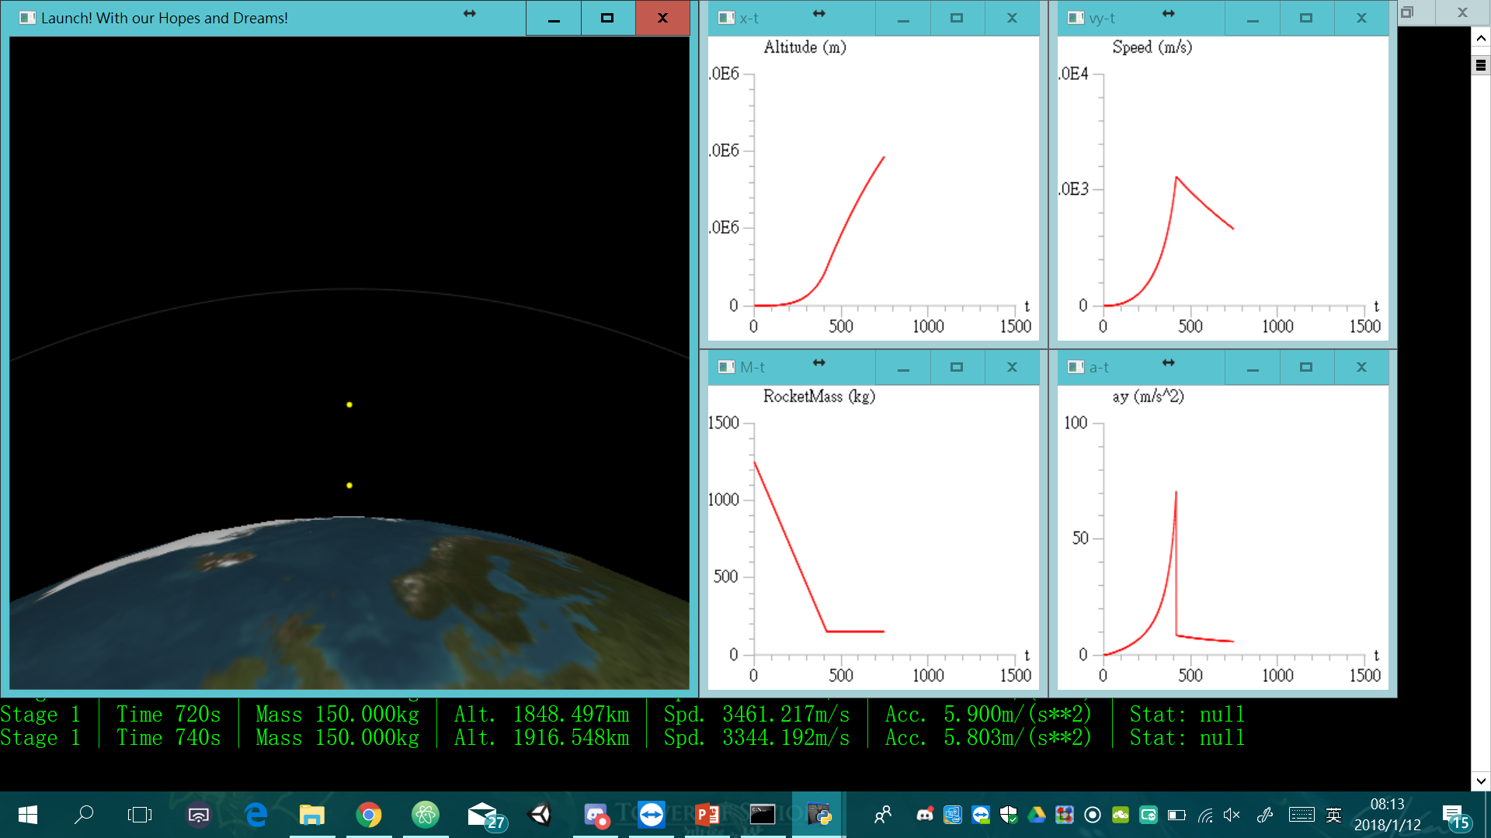

Slide 12
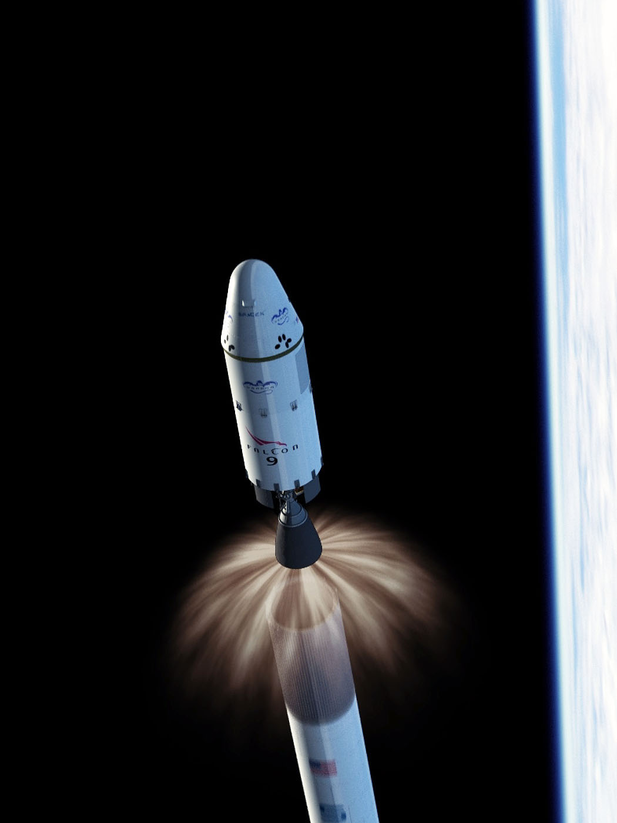
Phase 2: Stage 1 Separation & Stage 2 Ignition
Keep fixing the velocity
Try to make the rocket attach to the expected trail

Slide 13
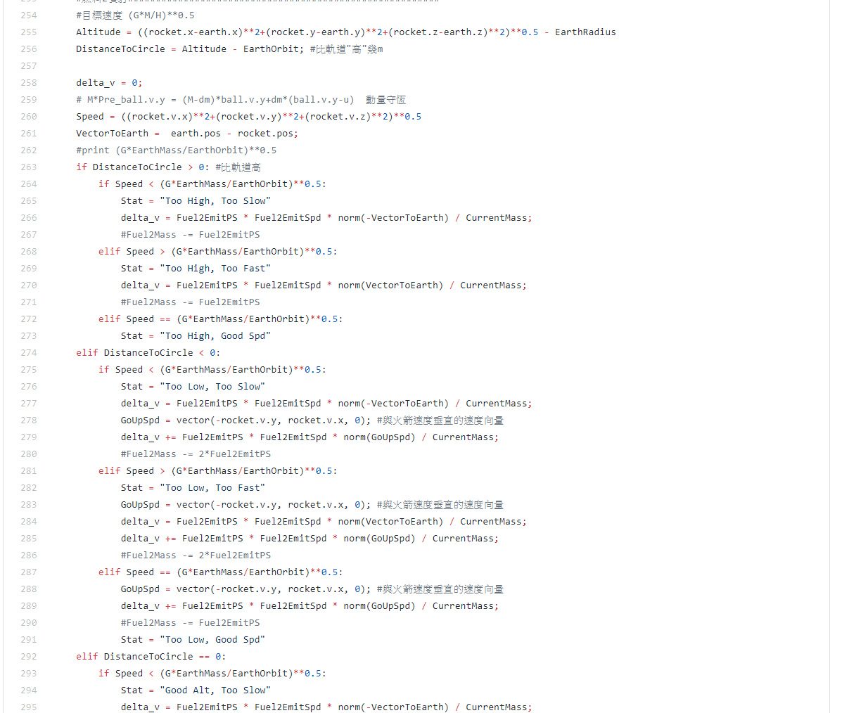
Phase 2: Stage 1 Separation & Stage 2 Ignition
Keep fixing the velocity
Try to make it attach to the expected trail

Slide 14
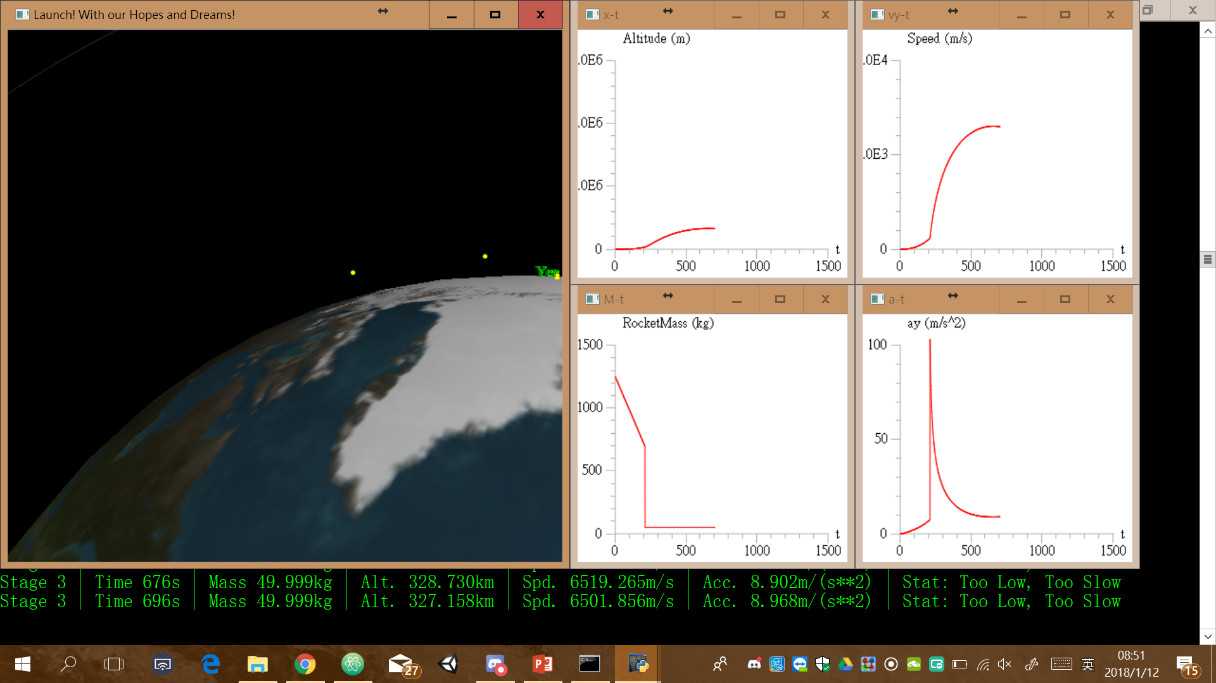
Notes:
LEO

Slide 15
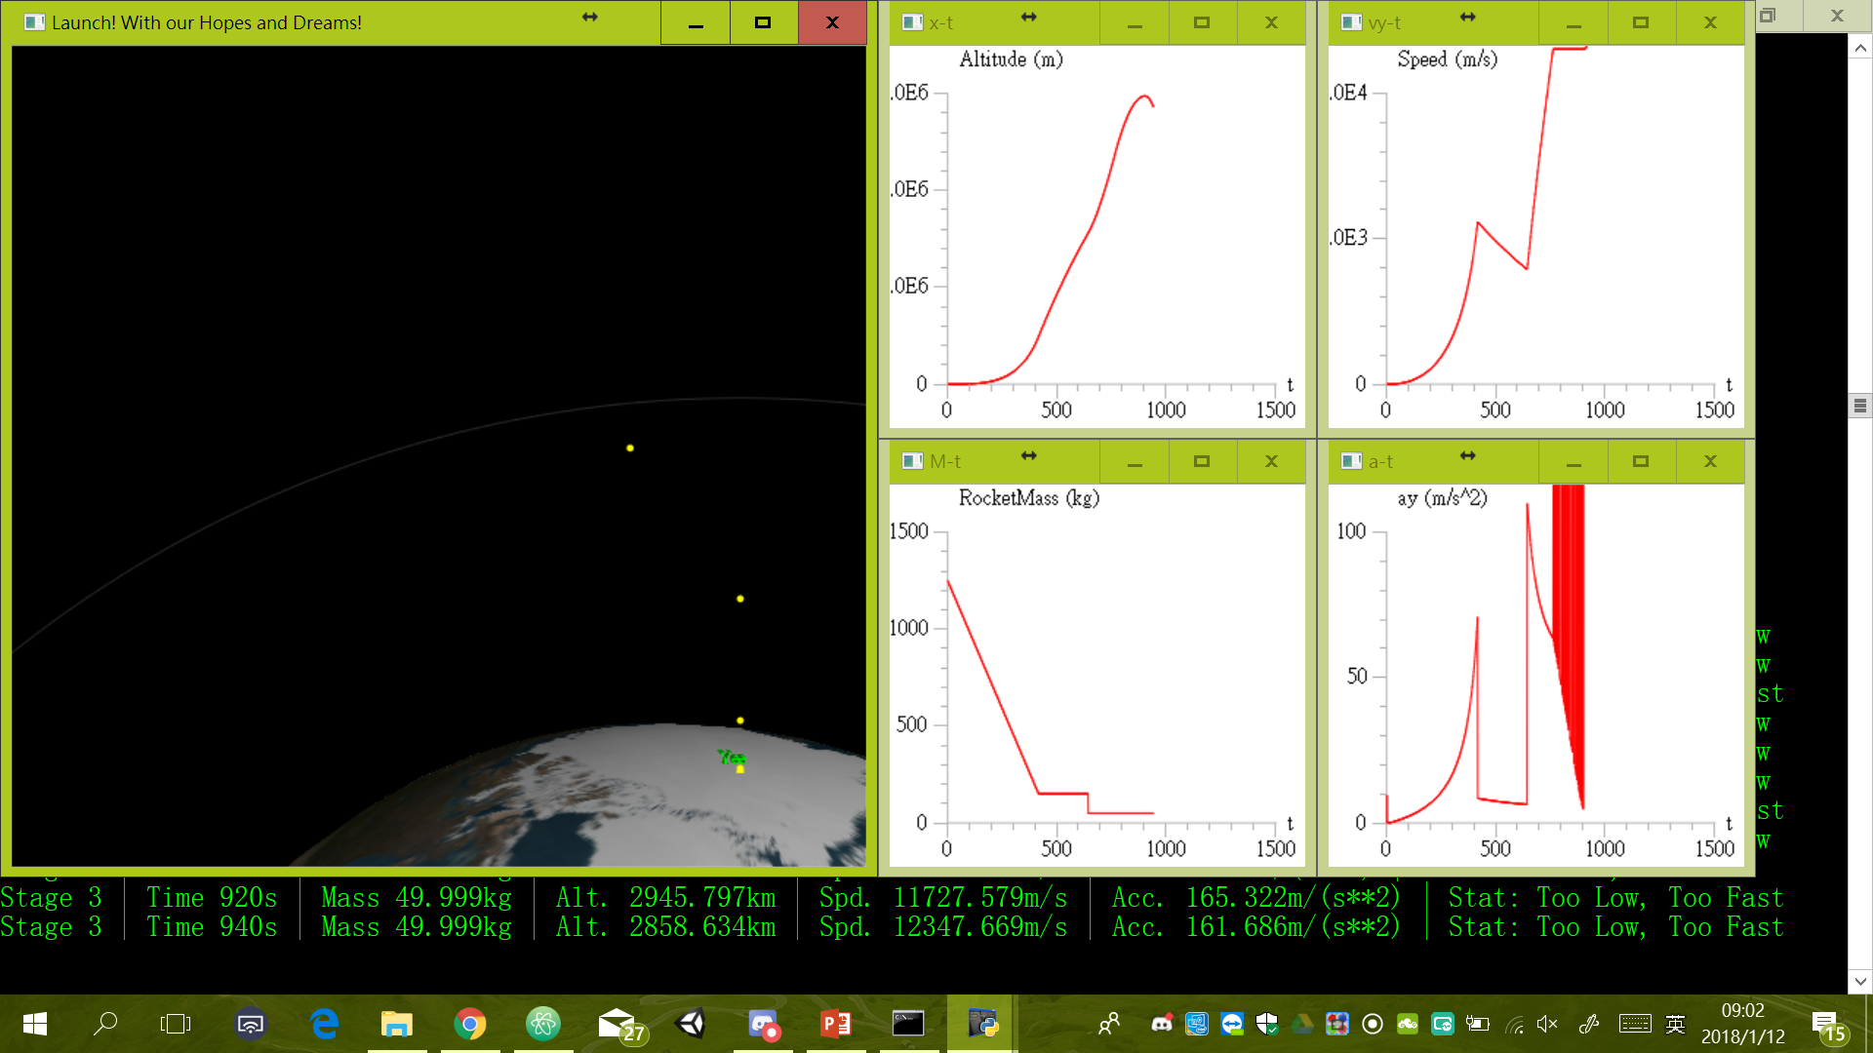

Slide 16
Conclusion
It can fly.
Notes:
功率轉換fail reason : keep fixing: always

Slide 17
Thoughts
Hard to search the “REAL” parameter
User Interface (?
Vpython is good for physic learning / educating, but its lagggggness…

Slide 18
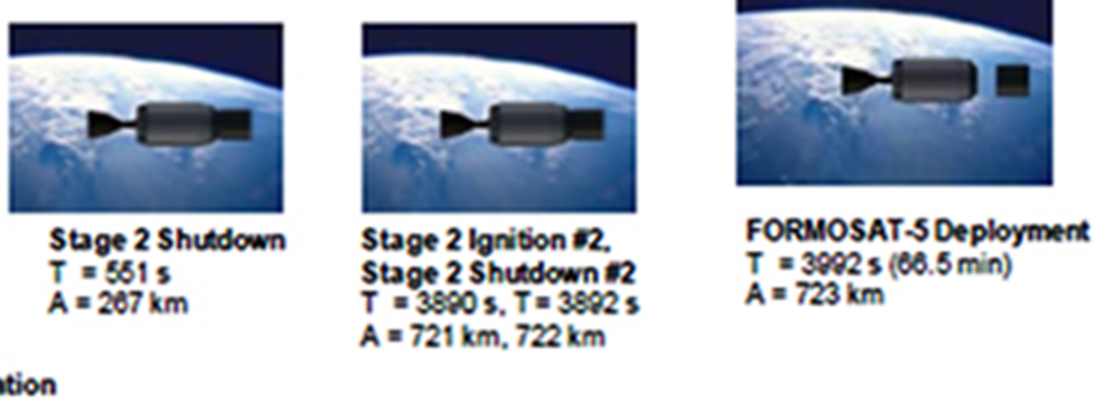
Simulation…Sorry
The simulation takes too much time.
Can’t modify “dt”
And also we often encounter “Memory Error” after we execute the program for quite a long time. (BUG of Vpy?)

Slide 19
Reference
福爾摩沙衛星五號 │ 發射載具 (n.d.). NSPO. Retrieved November 17, 2017, from
http://www.nspo.narl.org.tw/tw2015/projects/FORMOSAT-5/launch-vehicle.html,
什麼火箭可以豎直髮射而不會歪掉？ (2017, May). 資訊定製. Retrieved November 17, 2017, from
https://www.zixundingzhi.com/all/e122c4dba9f60768.html
FORMOSAT-5 Mission (2017, Aug). SpaceX. Retrieved January 11, 2018, from
http://www.spacex.com/sites/spacex/files/formosat5presskit.pdf
福爾摩沙衛星五號 (2017, Dec). 維基百科. Retrieved November 17, 2017, from
https://zh.wikipedia.org/wiki/%E7%A6%8F%E7%88%BE%E6%91%A9%E6%B2%99%E8%A1%9B%E6%98%9F%E4%BA%94%E8%99%9F

Slide 20

Thank you for Listening!

